Slide 1
Distribution Design Issues
Why fragment at all?
How to fragment?
How much to fragment?
How to test correctness?
How to allocate?
Information requirements?

Slide 2
Fragmentation
Can't we just distribute relations?
What is a reasonable unit of distribution?
  relation
    views are subsets of relations ➔locality
    extra communication
  fragments of relations (sub-relations)
    concurrent execution of a number of transactions that access different portions of a relation
    views that cannot be defined on a single fragment will require extra processing
    semantic data control (especially integrity enforcement) more difficult

Slide 3
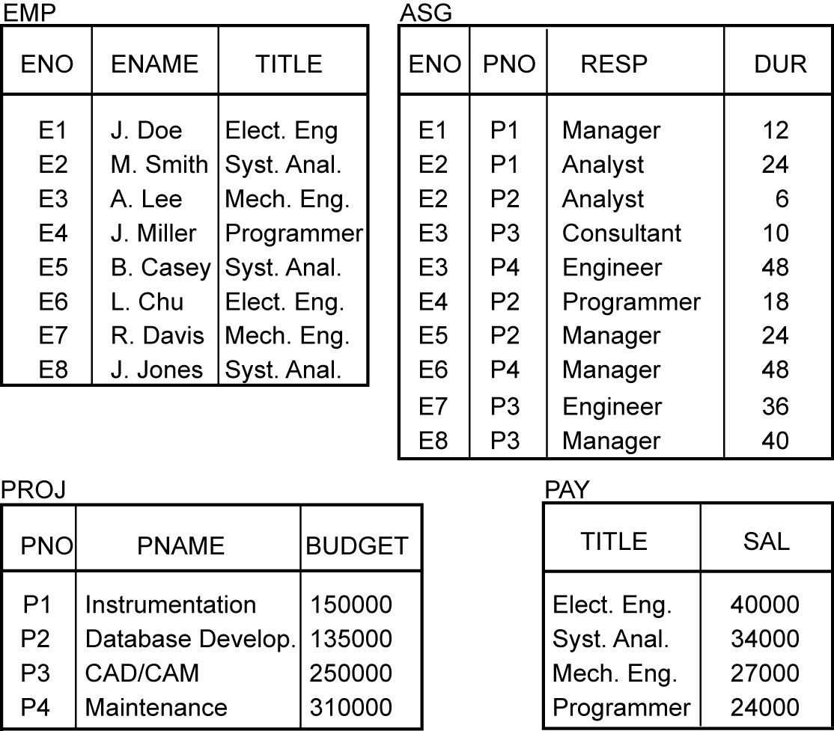
Example: how to fragment PROJ

Slide 4
Fragmentation Alternatives – Horizontal
PROJ
PROJ₁ : projects with budgets less than $200,000
PROJ₂ : projects with budgets greater than or equal to $200,000
PNO
PNAME
BUDGET
LOC
P1
Instrumentation
150000
Montreal
P2
Database Develop.
135000
New York
P3
CAD/CAM
250000
New York
P4
Maintenance
310000
Paris
P5
CAD/CAM
500000
Boston
PROJ₁
PROJ₂
PNO
PNAME
BUDGET
LOC
PNO
PNAME
BUDGET
LOC
P1
Instrumentation
150000
Montreal
P3
CAD/CAM
250000
New York
P2
Database Develop.
135000
New York
P4
Maintenance
310000
Paris
P5
CAD/CAM
500000
Boston

Slide 5
Fragmentation Alternatives – Vertical
PROJ
PROJ₁: information about project budgets
PROJ₂: information about project names and locations
PNO
PNAME
BUDGET
LOC
P1
Instrumentation
150000
Montreal
P2
Database Develop.
135000
New York
P3
CAD/CAM
250000
New York
P4
Maintenance
310000
Paris
P5
CAD/CAM
500000
Boston
PROJ₁
PROJ₂
PNO
BUDGET
PNO
PNAME
LOC
P1
150000
P1
Instrumentation
Montreal
P2
135000
P2
Database Develop.
New York
P3
250000
P3
CAD/CAM
New York
P4
310000
P4
Maintenance
Paris
P5
500000
P5
CAD/CAM
Boston

Slide 6
Degree of Fragmentation
finite number of alternatives
tuples
or
attributes
relations
Finding the suitable level of partitioning within this range

Slide 7
Correctness of Fragmentation
Completeness
  Decomposition of relation R into fragments R₁, R₂, ..., R_{n} is complete if and only if each data item in R can also be found in some R_{i}
Reconstruction
  If relation R is decomposed into fragments R₁, R₂, ..., R_{n}, then there should exist some relational operator ∇ such that
        R = ∇_{1≤i≤n}R_{i}
Disjointness
  If relation R is decomposed into fragments R₁, R₂, ..., R_{n}, and data item d_{i} is in R_{j}, then d_{i} should not be in any other fragment R_{k} (k ≠ j ).

Slide 8
Allocation Alternatives
Non-replicated
  partitioned : each fragment resides at only one site
Replicated
  fully replicated : each fragment at each site
  partially replicated : each fragment at some of the sites
read-only queries ☺
  Reliability and efficiency
  access the same data items can be executed in parallel since copies exist on multiple sites.
Update queries ☹
  cause trouble since the system has to ensure that all the copies of the data are updated properly.
  The decision regarding replication is a trade-off that depends on the ratio of the read-only queries to the update queries. This decision affects almost all of the distributed DBMS algorithms and control functions.

Slide 9
Comparison of Replication Alternatives
Full-replication
Partial-replication
Partitioning
QUERY
PROCESSING
Easy
Same Difficulty
DIRECTORY
MANAGEMENT
Easy or
Non-existant
Same Difficulty
CONCURRENCY
CONTROL
Moderate
Difficult
Easy
RELIABILITY
Very high
High
Low
REALITY
Possible
application
Realistic
Possible
application

Slide 10
Fragmentation
Horizontal Fragmentation (HF)
  Primary Horizontal Fragmentation (PHF)
  Derived Horizontal Fragmentation (DHF) =>will not be detailed
Vertical Fragmentation (VF)
Hybrid Fragmentation (HF)

Slide 11
PHF – Information Requirements
Database Information
  relationship
  cardinality of each relation: card(R)
SKILL
TITLE, SAL
L₁
EMP
PROJ
ENO, ENAME, TITLE
PNO, PNAME, BUDGET, LOC
ASG
ENO, PNO, RESP, DUR

Slide 12
PHF - Information Requirements
Application Information
  simple predicates : Given R[A₁, A₂, …, A_{n}], a simple predicate p_{j} is
    p_{j} : A_{i} θValue
  where θ ∈ {=,<,≤,>,≥,≠}, Value ∈ D_{i} and D_{i} is the domain of A_{i}.
  For relation R we define Pr = {p₁, p₂, …,p_{m}}
  Example :
      PNAME = "Maintenance"
      BUDGET ≤ 200000
  minterm predicates : Given R and Pr = {p₁, p₂, …,p_{m}}
  define M = {m₁,m₂,…,m_{r}} as
  M = { m_{i} | m_{i} = ∧_{pj∈Pr} p_{j}* }, 1≤j≤m, 1≤i≤z
  where p_{j}* = p_{j} or p_{j}* = ¬(p_{j}).

Slide 13
PHF – Information Requirements
Consider relation PAY.
The following are some of the possible simple
predicates that can be defined on PAY.
            p1: TITLE = “Elect. Eng.”
            p2: TITLE = “Syst. Anal.”
            p3: TITLE = “Mech. Eng.”
            p4: TITLE = “Programmer”
            p5: SAL <= 30000
            P6: SAL > 30000
The following are some of the minterm predicates that can be defined based on these simple predicates.
            m1: TITLE = “Elect. Eng.” ^ SAL <= 30000
            m2: TITLE = “Elect. Eng.” ^ SAL > 30000
            m3: :(TITLE = “Elect. Eng.”) ^ SAL <= 30000
            m4: :(TITLE = “Elect. Eng.”) ^ SAL > 30000
            m5: TITLE = “Programmer” ^ SAL <= 30000
            m6: TITLE = “Programmer” ^ SAL > 30000

Slide 14
PHF – Information Requirements
Application Information
  minterm selectivities: sel(m_{i})
    The number of tuples of the relation that would be accessed by a user query which is specified according to a given minterm predicate m_{i}.
Example
  m1: TITLE = “Elect. Eng.” ^ SAL < 30000
  The selectivity of m1 is 0
  m2: TITLE = “Elect. Eng.” ^ SAL > 30000
The selectivity of m2 is 0.25

Slide 15
PHF – Information Requirements
Application Information
  access frequencies: acc(q_{i})
    The frequency with which a user application qi accesses data.
    Access frequency for a minterm predicate can also be defined.

Slide 16
Primary Horizontal Fragmentation
Definition :
      R_{j} = σ_{Fj}(R), 1 ≤ j ≤ w
  where F_{j} is a selection formula, which is (preferably) a minterm predicate.
Therefore,
  A horizontal fragment R_{i} of relation R consists of all the tuples of R which satisfy a minterm predicate m_{i}.
⬇
  Given a set of minterm predicates M, there are as many horizontal fragments of relation R as there are minterm predicates.
  Set of horizontal fragments also referred to as minterm fragments.

Slide 17

Example 3.7 :
The decomposition of relation PROJ into horizontal fragments PROJ1 and PROJ2 :
PROJ
PNO
PNAME
BUDGET
LOC
P1
Instrumentation
150000
Montreal
P2
Database Develop.
135000
New York
P3
CAD/CAM
250000
New York
P4
Maintenance
310000
Paris
P5
CAD/CAM
500000
Boston
PROJ₁
PROJ₂
PNO
PNAME
BUDGET
LOC
PNO
PNAME
BUDGET
LOC
P1
Instrumentation
150000
Montreal
P3
CAD/CAM
250000
New York
P2
Database Develop.
135000
New York
P4
Maintenance
310000
Paris
P5
CAD/CAM
500000
Boston

Slide 18
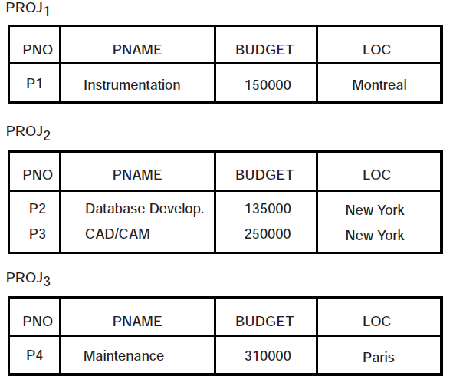
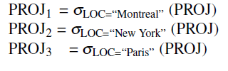
Example 3.8.
We can define the following horizontal fragments based on the project location. The resulting fragments are shown

Slide 19
PHF – Algorithm
Given: A relation R, the set of simple predicates Pr
Output: The set of fragments of R = {R₁, R₂,…,R_{w}} which obey the fragmentation rules.
Preliminaries :
  Pr should be complete
  Pr should be minimal

Slide 20
Completeness of Simple Predicates
A set of simple predicates Pr is said to be complete if and only if the accesses to the tuples of the minterm fragments defined on Pr requires that two tuples of the same minterm fragment have the same probability of being accessed by any application.
Example :
  Assume PROJ[PNO,PNAME,BUDGET,LOC] has two applications defined on it.
  Find the budgets of projects at each location. (1)
  Find projects with budgets less than $200000. (2)

Slide 21
Example (Completeness of Simple Predicates)
According to (1),
  Pr={LOC=“Montreal”,LOC=“New York”,LOC=“Paris”}
which is not complete with respect to (2).
Modify
  Pr ={LOC=“Montreal”,LOC=“New York”,LOC=“Paris”, BUDGET≤200000,BUDGET>200000}
which is complete.

Slide 22
Minimality of Simple Predicates
If a predicate influences how fragmentation is performed, (i.e., causes a fragment f to be further fragmented into, say, f_{i} and f_{j}) then there should be at least one application that accesses f_{i} and f_{j} differently.
In other words, the simple predicate should be relevant in determining a fragmentation.
If all the predicates of a set Pr are relevant, then Pr is minimal.

Slide 23
Example (Minimality of Simple Predicates)
Example :
  Pr ={LOC=“Montreal”,LOC=“New York”, LOC=“Paris”,
    BUDGET≤200000,BUDGET>200000}
is minimal (in addition to being complete). However, if we add
  PNAME = “Instrumentation”
then Pr is not minimal.

Slide 24
PHF – Example1
Two candidate relations : PAY and PROJ.
Fragmentation of relation PAY
  Application: Check the salary info and determine raise.
  Employee records kept at two sites ⇒ application run at two sites
  Simple predicates
    p₁ : SAL ≤ 30000
    p₂ : SAL > 30000
    Pr = {p₁,p₂} which is complete and minimal
  Minterm predicates
    m₁ : (SAL ≤ 30000)
    m₂ : NOT(SAL ≤ 30000) = (SAL > 30000)

Slide 25
PHF – Example1
PAY₁
PAY₂
TITLE
SAL
TITLE
SAL
Mech. Eng.
27000
Elect. Eng.
40000
Programmer
24000
Syst. Anal.
34000

Slide 26
PHF – Example2
Fragmentation of relation PROJ
  Application:
    Find the name and budget of projects given their no.
      Issued at three sites
    Access project information according to budget
      one site accesses ≤200000 other accesses >200000
  Simple predicates
  For point (1)
    p₁ : LOC = “Montreal”
    p₂ : LOC = “New York”
    p₃ : LOC = “Paris”
  For point (2)
    p₄ : BUDGET ≤ 200000
    p₅ : BUDGET > 200000
  Pr = {p₁,p₂,p₃,p₄,p₅}

Slide 27
PHF – Example2
Fragmentation of relation PROJ continued
  Minterm fragments left after elimination
    m₁ : (LOC = “Montreal”) ∧ (BUDGET ≤ 200000)
    m₂ : (LOC = “Montreal”) ∧ (BUDGET > 200000)
    m₃ : (LOC = “New York”) ∧ (BUDGET ≤ 200000)
    m₄ : (LOC = “New York”) ∧ (BUDGET > 200000)
    m₅ : (LOC = “Paris”) ∧ (BUDGET ≤ 200000)
    m₆ : (LOC = “Paris”) ∧ (BUDGET > 200000)

Slide 28
PHF – Example
PROJ₁
PROJ₂
PNO
PNAME
BUDGET
LOC
PNO
PNAME
BUDGET
LOC
P1
Instrumentation
150000
Montreal
P2
Database
Develop.
135000
New York
PROJ₄
PROJ₆
PNO
PNAME
BUDGET
LOC
PNO
PNAME
BUDGET
LOC
P3
CAD/CAM
250000
New York
P4
Maintenance
310000
Paris

Slide 29
PHF – Correctness
Completeness
  Since Pr' is complete and minimal, the selection predicates are complete
Reconstruction
  If relation R is fragmented into F_{R} = {R₁,R₂,…,R_{r}}
        R = ∪_{∀Ri ∈FR} R_{i}
Disjointness
  Minterm predicates that form the basis of fragmentation should be mutually exclusive.

Slide 30
Vertical Fragmentation
Has been studied within the centralized context
  design methodology
  physical clustering
More difficult than horizontal, because more alternatives exist.
Two approaches :
  grouping
    attributes to fragments
  splitting
    relation to fragments

Slide 31
Hybrid Fragmentation
R
HF
HF
R₁
R₂
VF
VF
VF
VF
VF
R₁₁
R₁₂
R₂₁
R₂₂
R₂₃

Slide 32
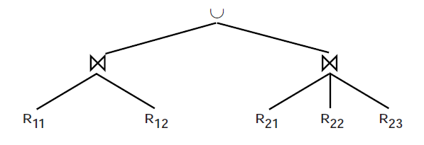

Slide 33
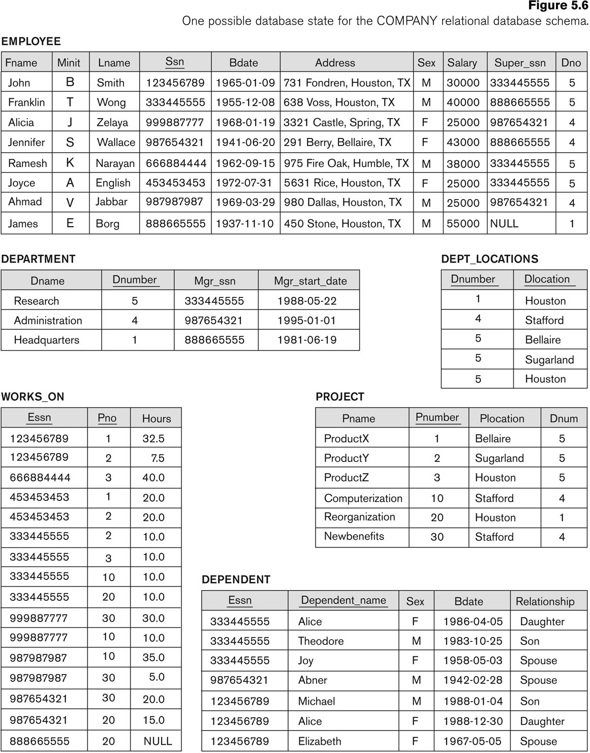
Homework with SQL server(1)
Create1HF for this table =>2 fragments (salary <30000) and (salary>=30000)
Create 1 VF for this table =>2 fragments (Fname,minit,Lname,ssn,Bdate) and (ssn,Address,sex, salary,superssn,dno)
Create 1 HybF for this table =>start with PF then VF

Slide 34
Homework with SQL server(2)
Q1 List the name of employees working in Dno 4
Q2 List the ssn and name of employees with a salary more than 30000
Q3 List the ssn and name of female employees working in Dno5
Q4 Find the average of salaries
Q5 Find the ssn of the employees working in Dno 4 or 5
Q6 Find the total number of employees
Q7 Find the highest salary

Slide 35
Fragment Allocation
Problem Statement
  Given
      F = {F₁, F₂, …, F_{n}} fragments
      S ={S₁, S₂, …, S_{m}} network sites
      Q = {q₁, q₂,…, q_{q}} applications
  Find the "optimal" distribution of F to S.
Optimality
  Minimal cost
    Communication + storage + processing (read & update)
    Cost in terms of time (usually)
  Performance
    Response time and/or throughput
  Constraints
    Per site constraints (storage & processing)

Slide 36
Information Requirements
Database information
  selectivity of fragments
  size of a fragment
Application information
  access types and numbers
  access localities
Communication network information
  unit cost of storing data at a site
  unit cost of processing at a site
Computer system information
  bandwidth
  latency
  communication overhead

Slide 37
Allocation
File Allocation (FAP) vs Database Allocation (DAP):
  Fragments are not individual files
    relationships have to be maintained
  Access to databases is more complicated
    remote file access model not applicable
    relationship between allocation and query processing
  Cost of integrity enforcement should be considered
  Cost of concurrency control should be considered

Slide 38
Allocation – Information Requirements
Database Information
  selectivity of fragments
  size of a fragment
Application Information
  number of read accesses of a query to a fragment
  number of update accesses of query to a fragment
  A matrix indicating which queries updates which fragments
  A similar matrix for retrievals
  originating site of each query
Site Information
  unit cost of storing data at a site
  unit cost of processing at a site
Network Information
  communication cost/frame between two sites
  frame size

Slide 39
Allocation Model
General Form
minimize (Total Cost)
subject to:
response time constraint
storage constraint
processing constraint
Decision Variable
1 if fragment F_{i} is stored at site S_{j}
x_{ij} =
0 otherwise

Slide 40
Allocation Model
Total Cost
Storage Cost (of fragment F_{j} at S_{k})
Query Processing Cost (for one query)
  processing component + transmission component
∑
query processing cost +
all queries
∑
∑
cost of storing a fragment at a site
all sites
all fragments
(unit storage cost at S_{k}) ∗ (size of F_{j}) ∗ x_{jk}

Slide 41
Allocation Model
Query Processing Cost
  Processing component
    access cost + integrity enforcement cost + concurrency control cost
  Access cost
  Integrity enforcement and concurrency control costs
    Can be similarly calculated
∑
∑
(no. of update accesses+ no. of read accesses) ∗
all sites
all fragments
x_{ij} ∗ local processing cost at a site

Slide 42
Allocation Model
Query Processing Cost
  Transmission component
    cost of processing updates + cost of processing retrievals
  Cost of updates
  Retrieval Cost
∑
∑
update message cost +
all sites
all fragments
∑
∑
acknowledgment cost
all sites
all fragments
∑
min
(cost of retrieval command +
all sites
all fragments
cost of sending back the result)

Slide 43
Allocation Model
Constraints
  Response Time
    execution time of query ≤ max. allowable response time for that query
  Storage Constraint (for a site)
  Processing constraint (for a site)
∑
storage requirement of a fragment at that site ≤
all fragments
storage capacity at that site
∑
processing load of a query at that site ≤
all queries
processing capacity of that site

Slide 44
Allocation Model
Attempts to reduce the solution space
  assume all candidate partitionings known; select the “best” partitioning
  ignore replication at first
  sliding window on fragments

